Slide 1
Lab-project

Slide 2
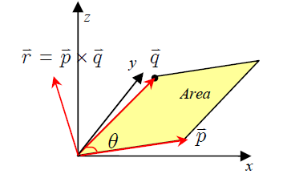

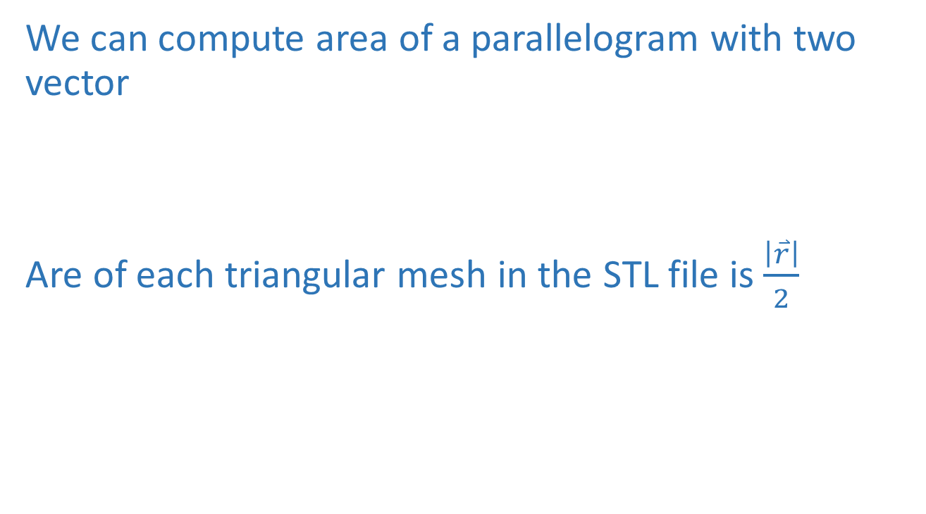
Exercise 1-1
We can compute area of a parallelogram with two vector
Are of each triangular mesh in the STL file is $\frac{\left|\overset{⃑}{r}\right|}{2}$

Slide 3
Exercise 1-1
Question: Based on the given visSTL.py, develop a python program which can
1) Read and visualize STL files of the given tessa_vase_filled.stl and Twisted_Vase_Basic_Voronoi_Style.stl;
2) Rotate about x-axis for π/4 clock-wise and then about y-axis for π/3 counter-clock-wise. In the
first method, create your own rotation matrices and apply them to each one of the vertices. In the
second method, directly use the function “mesh.rotate()” in numpy-stl. Visually show the the
original and the rotated models and compare the results from the two methods. Note that
“mesh.rotate()” implementation in stl package uses row vectors instead of column vectors, and
therefore the rotation matrix is multiplied from the right of row vectors.
3) Calculate the total surface area for each of the two models. In the first method, calculate the
area for each triangular surface using cross-product as discussed in class and add all of them
together. In the second method, directly use “mesh.areas” in numpy-stl and sum them up. Compare
the results from the two methods.

Slide 4
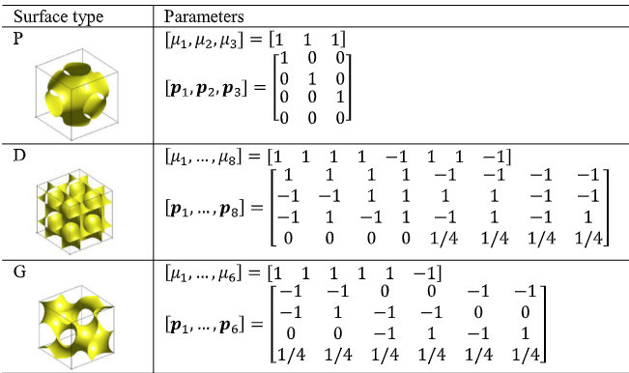

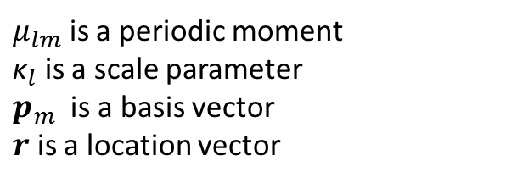
Exercise 1-2: Program periodic surfaces
Periodic surfaces:
$μ_{lm}$ is a periodic moment
${\text{κ}}_{l}$ is a scale parameter
$p_{m}$ is a basis vector
$r$ is a location vector
Construct a function in Python with $μ_{lm}$, ${\text{κ}}_{l}$ and $p_{m}$ as inputs and $ψ$ as output
Plot P, D, and G types of surface with your function. You can choose any scale parameter.
Lu, Y., & Wang, Y. (2022). Structural optimization of metamaterials based on periodic surface modeling. Computer Methods in Applied Mechanics and Engineering, 395, 115057.

Slide 5
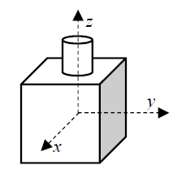
Exercise 1-3
Visualize a sphere centered at (0,0,0) with radius of 1, report formulation and results.
The visualization of implicit surface f(x,y,z)=0 is to show the isosurface from a 3D volume of f functional values.
(2) Visualize the union of a box and a cylinder, report formulation and results.
Each side of the box has the length of 1 along x-, y-, and z-direction and its center is at (0,0,0). The center axis of the cylinder is aligned with z-axis. The diameter of the cylinder is 0.2 and the height is 0.2. Make sure the union between the box and cylinder is seamless. You should use both min/max function and R-function for Boolean operations and compare the results.
(3) Generate metamorphosis between the sphere in (1) and the box-cylinder in (2), report formulation and results with 11 screen-captured pictures.
Create a 10-step linear metamorphosis process with 9 intermediate images between the sphere and boxcylinder models (use min/max version of box-cylinder here).

Slide 6
Exercise 2
A swivel C bracket is mounted to a ceiling of a building and has a speaker (not shown) of 20 lbf hanging from each mounting hole. The mounting bracket is made of A 36 steel with a modulus of elasticity of 29 x10⁶ psi, Poisson’s ratio of 0.29, and yield strength of 36,000 psi. Determine the maximum von Mises stress and deflection in the bracket.

Slide 7
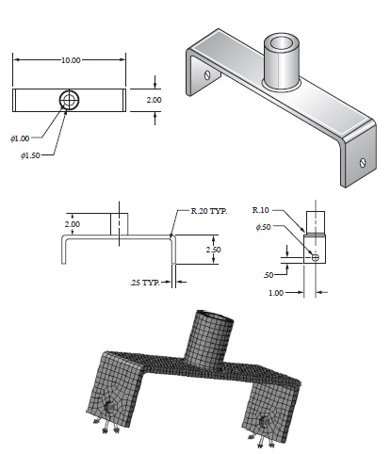
Exercise 2
You may create this geometry with CAD software or Python
Dimensions in inches
Parasolid format is recommended: File->Import->PARA…

